Slide 1
MasterMove
Double Oreo

Slide 2
Table of contents
01
02
03
04
05
Advantages
Technologies used
How our app works
Future development
Our Team & Experience

Slide 3
Advantages over other apps
Expert support
Social element
Variety of courses
Interactivity

Slide 4



Technologies used

Slide 5
How our app works

Slide 6
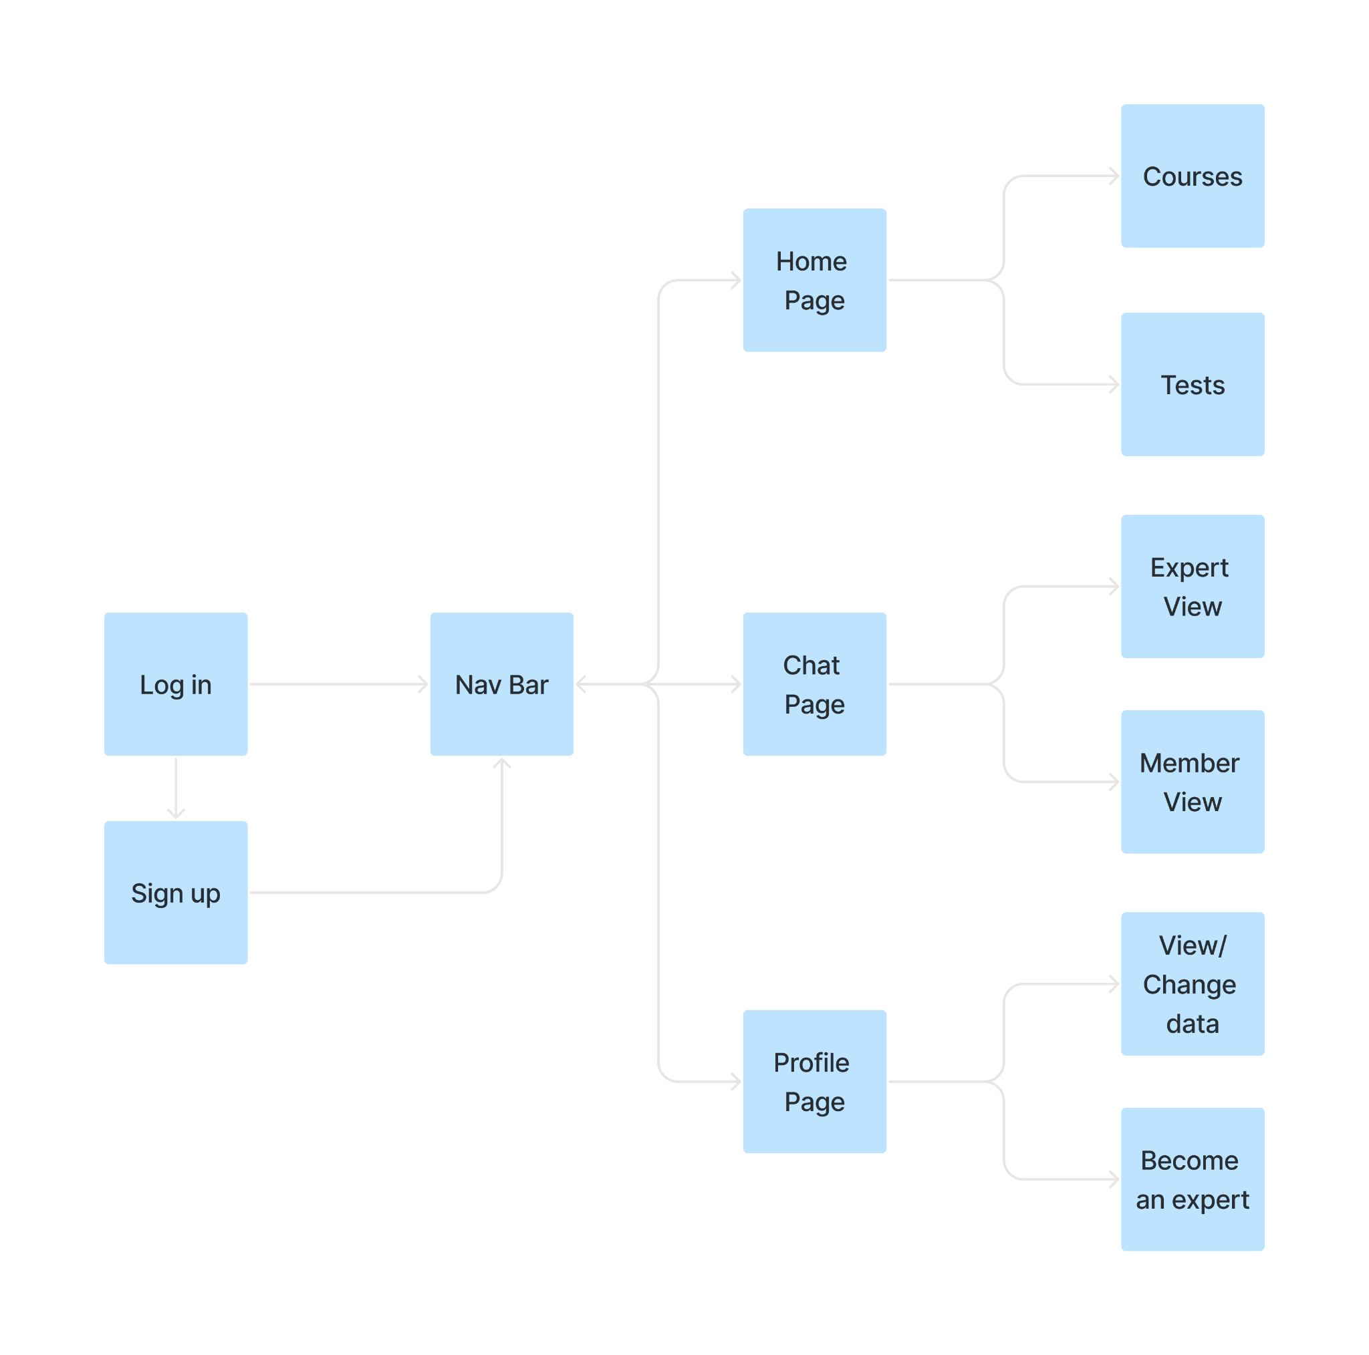

Slide 7
Demo

Slide 8
Future development
More courses
More hobbies
Make a subscription plan
Better and improved videos

Slide 9
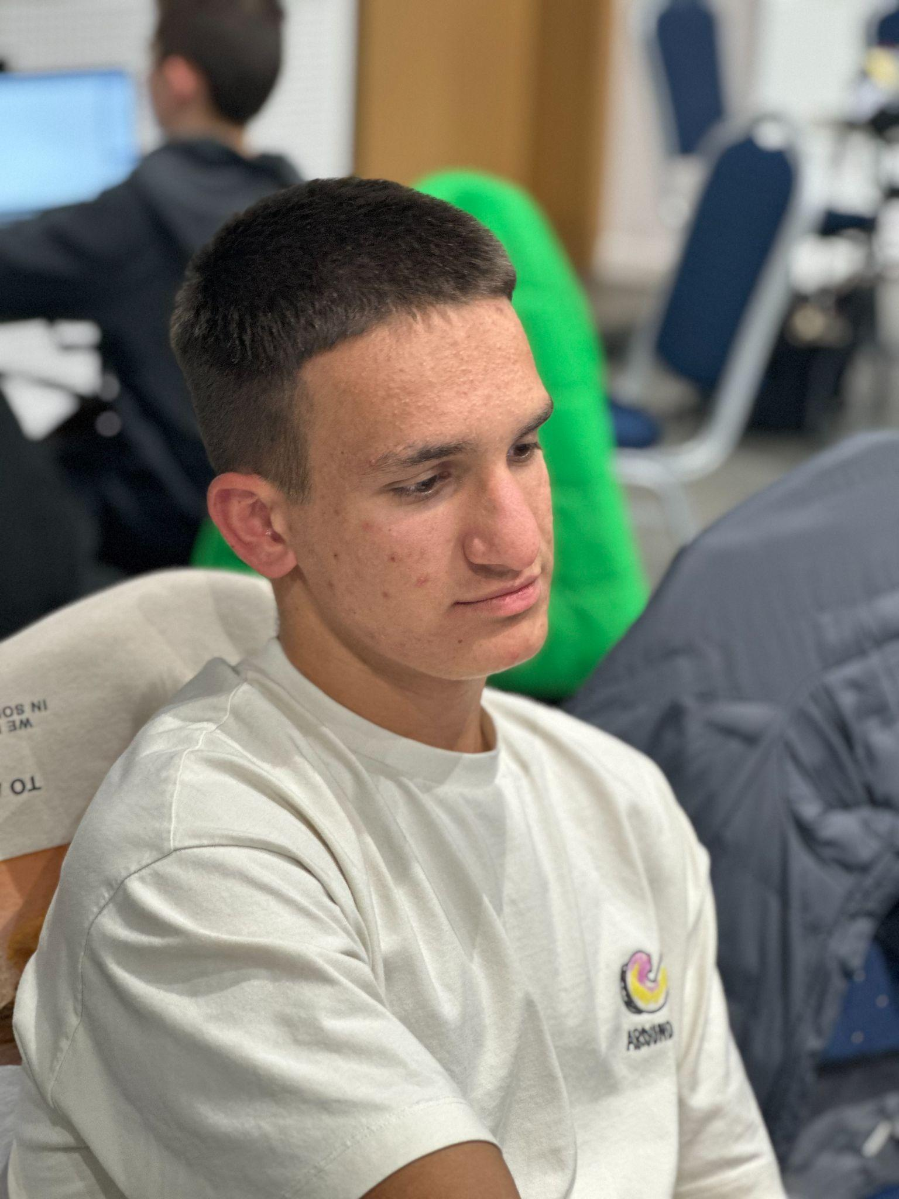
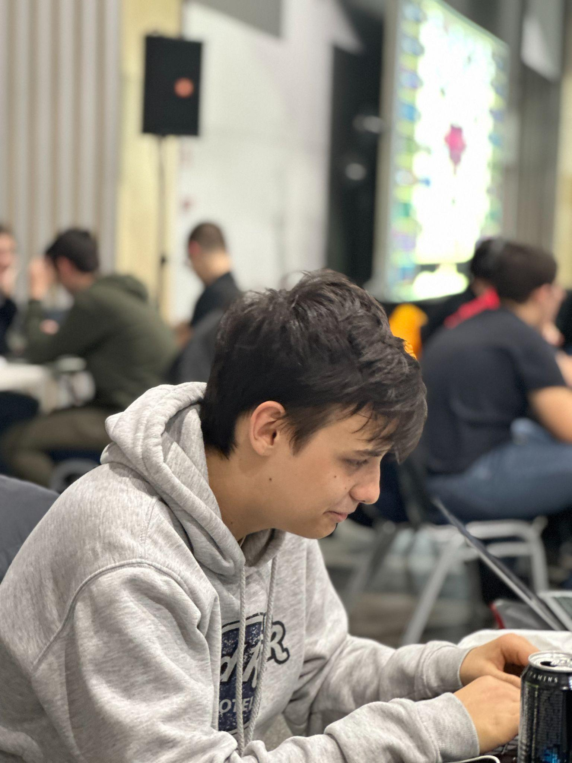
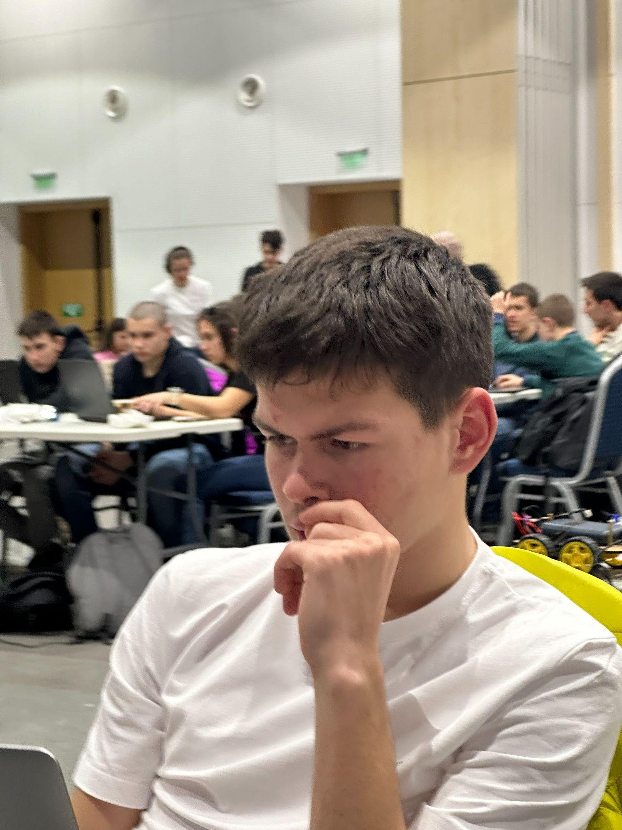
Kaloyan
Kristiyan
Mark

Slide 10
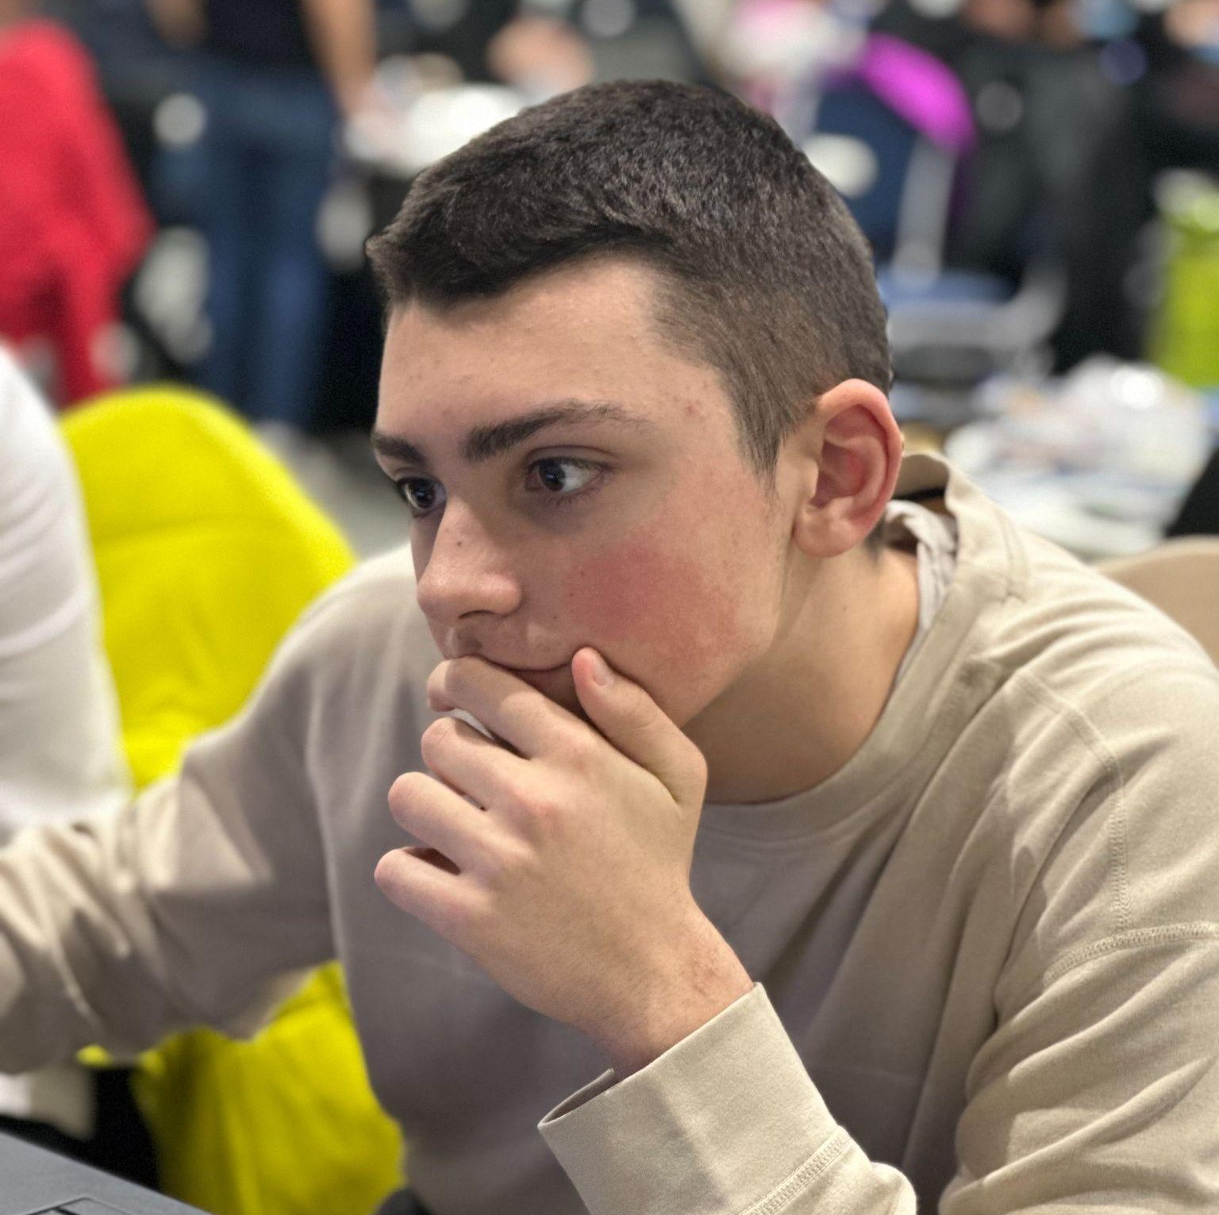

Filip
Vasil

Slide 11
Our experience

Slide 12
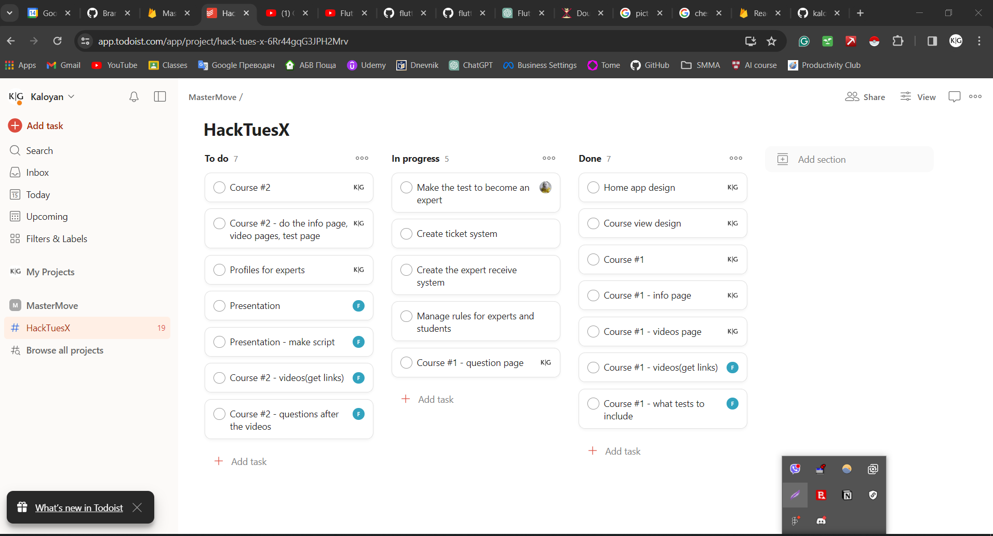

Slide 13
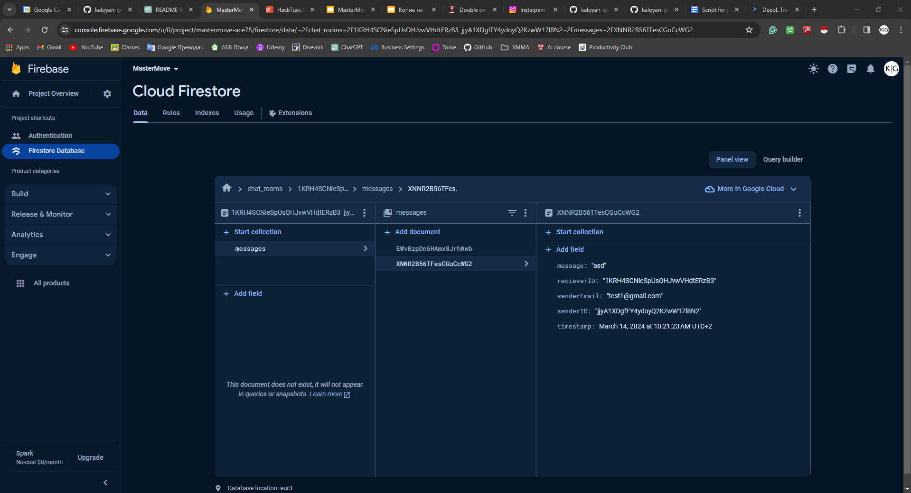

Slide 14
Thanks for your attention!

